Slide 1

Discovering Homes for a Quick Profit in Ames, Iowa – Executive Presentation
Date: 04/01/20
Presenter: Sisank Kotwal

Slide 2
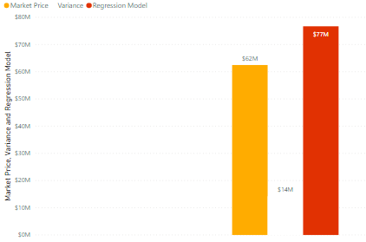
There is a profit of $14.23M to be made. It was found by identifying homes that are undervalued by at least 10% and therefore are priced to move, ensuring that our capital is utilized safely without getting tied up in relatively slow-moving inventory.
Key Metrics
398 out of 1460 homes are undervalued by
at least 10%
$62.47M total sale price for all 398 homes
$76.70M estimated return for all 398 homes
$14.23M estimated profit for a
profit margin of 22.78%
$14M
Key Takeaway
Initial investment of $3.40M to capture $14.23M of profit for ROI of 318.53%
Use $3.40M investment’s ROI to continually make strategic investments. May need additional capital to continue investing, but highly unlikely.
Notes:
Plot pump failure to regression equation

Slide 3
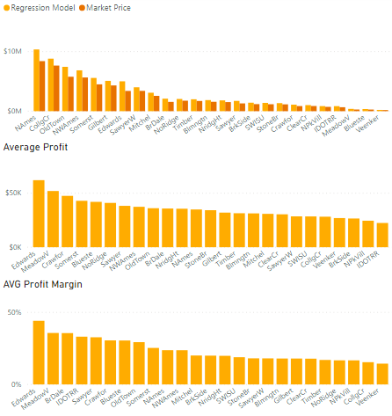
Looking for properties with high return on investments and large profits while keeping capital expenditure at a safe level will help us utilize our money efficiently with minimal risk. Investing in Edwards neighborhood allows us to use only $3.40M of capital to capture all or most of the profit in the market by rolling the profits from the Edwards investment into future investments.
Investing Strategies
Highest Profits - Invest in neighborhoods with the most profit first
Pros: Biggest returns at start of investing, initial investment should cover following investments
Cons: Biggest investment
Highest Profit Margin – Invest in neighborhoods with greatest profit margin first
Pros: Gain best ROI with initial investments, use profits for next investments
Cons: Medium initial investment
Lowest Cost – Invest in neighborhoods requiring lowest investment upfront
Pros: Uses least amount of money to start with, use profits for next investments
Cons: Lowest profit, may need capital for next investment
$5.01M
$3.40M
$4M
$1.61M Total Profit
44.17%
Recommendation
The Edwards neighborhood was strategically chosen because it has the best ROI, biggest profit, and medium-sized capital requirement.
Notes:
Plot pump failure to regression equation

Slide 4
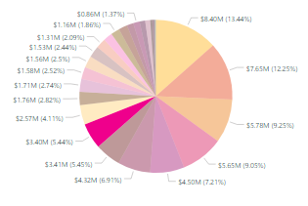
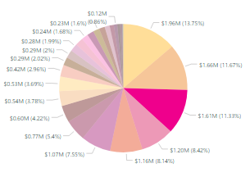
Investing in Edwards neighborhood allows us to use only $3.40M of capital to capture all or most of the profit in the market by rolling the profits from the Edwards investment into future investments.
Why Edwards Neighborhood?
$1.61M profit – 3rd most profit out of all neighborhoods
44.17% ROI - best ROI out of all neighborhoods
$3.40M investment is a medium-sized investment; only 5.4% share of market value
11.3% share of profit while only spending 5.4% of undervalued homes total market value
Only 26 homes to invest in w/ an average profit of $62K
Average home price is $130K vs. $157K for all undervalued homes
Neighborhood Market Price
Neighborhood Profit

Slide 5
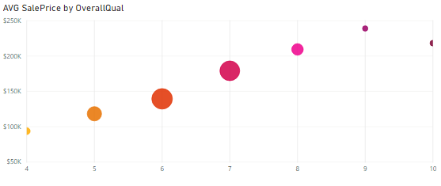
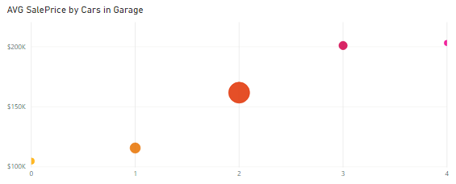
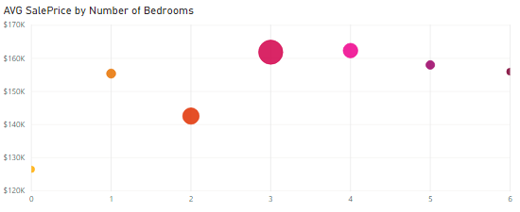
We can also extract more profit by increasing the value of a home through home-improvement projects that increase the quality and condition of homes as well as upgrading or adding other features.
It may not always be feasible to improve a characteristic as the cost for it may outweigh the increase in value.
Our Regression Model shows the following values for each variable:
Variable | Value
OverallQual | 23,120
OverallCond | 7,656
GrLivArea | 53
FullBath | 19,180
Cars in Garage | 20,140

Slide 6
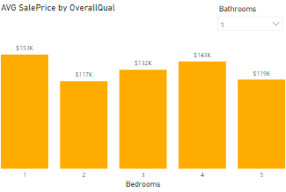
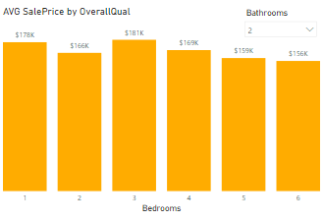
Our research shows the following: improving OverallQual by 1 point increases a home’s value by $23,120; 3-bedroom homes with either 1 or 2 bathrooms are valued on average $15K more than 2-bedroom homes.
Home Improvement Recommendations
Improving OverallQual is recommended as it is likely always cost-effective to increase the score by at least 1 and therefore increase the home value on average of $23K.
Whenever possible, making a 2-bedroom home into a 3-bedroom home will increase a homes value by an estimated $15K, but it is important to be mindful of the renovation costs.
AVG Market Price by Bedroom and Bathroom
AVG Market Price by Bedroom and Bathroom

Slide 7
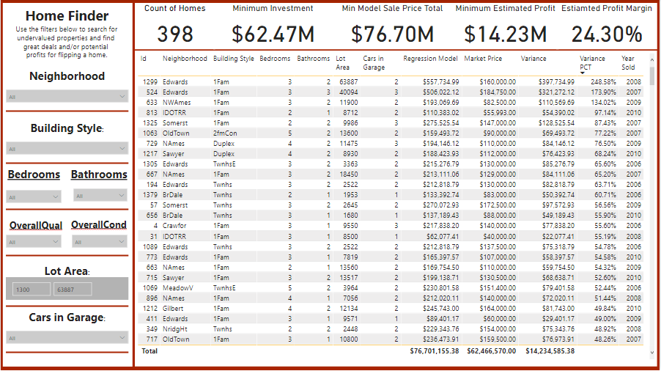
The dashboard helps our team explore homes that are undervalued by 10% from their fair-value.

